Slide 1

by Miguel Estepa & Vicky Zauner
Series Success and Rise of Popularity by Movies and Books measured by total Sales and Awareness on Youtube

Slide 2


May we introduce ourselves...👾
Miguel Estepa
Chief Creative Data Science Officer at Warner Bros and a nerdy Ravenclaw
Vicky Zauner
Chief Creative Data Science Officer at Warner Bros. and a Gryffindor

Slide 3
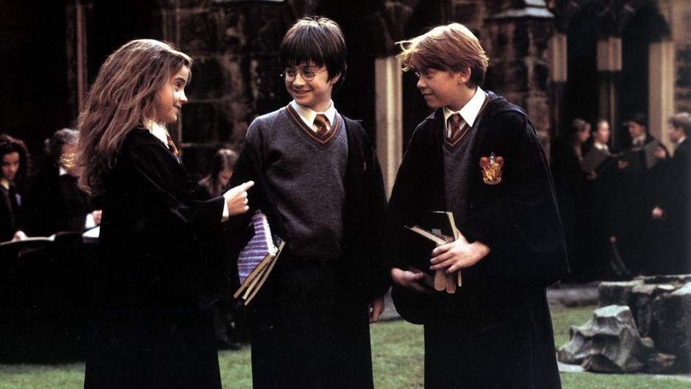
General Harry Potter Information🌟
Movies:
1: 2001
2: 2002
3: 2004
4: 2005
5: 2007
6: 2009
7: 2010, 2011
Books published US:
1: 09/1998
2: 06/1999
3: 09/1999
4: 07/2000
5: 06/2003
6: 07/2005
7: 07/2007

Slide 4
Questions and Hypothesis / Project Goals ❓
Goals:
to illustrate the Success and Contribution to the Popularity of the Harry Potter Series of each movie and book over time using Youtube views and Sales
Hypothesis:
Which Harry Potter Movie and Book was the most popular / successful?
How does the number of View Counts of Youtube Videos related to Harry Potter develop over time?
How is the number of View Counts affected by movie releases?
Which Trailer was the most successful according to Box Office Sales?
How does the View Count of Official Trailers on Youtube relate to the Success of the Movie?

Slide 5
Considerations & Assumptions, Data & Limitations
Data Used: Youtube API, CSV Files, WebScraping from Numbers.com and Wikipedia
Considerations and Assumptions:
Youtube’s views is an indicator for the overall popularity of the Harry Potter Saga
Our indicators for Success stem from Box Office Sales, Video Sales and total Book Copies Sold
Data and Limitations:
Youtube View Counts is affected by the growth in Youtube Users
Many more products in the HP Theme were sold that could indicate further growth
Youtube data is diverse, unspecific and flawed but portrays an overall trend

Slide 6
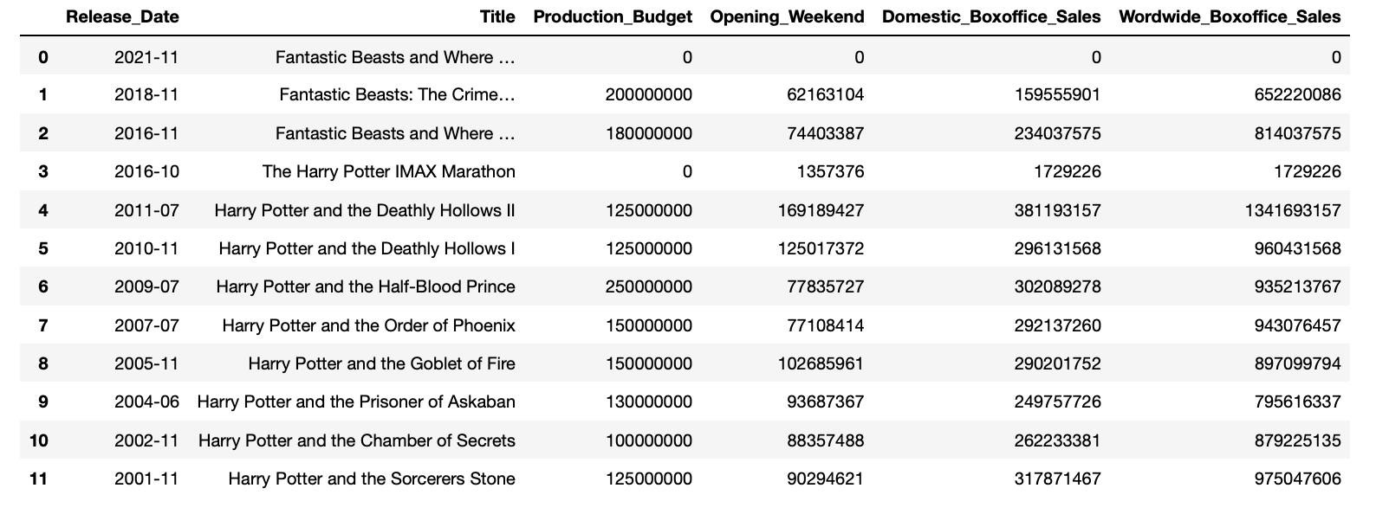
Analysis 1
Which Harry Potter Movie and Book was the most popular / successful?
Notes:
calucalte changes

Slide 7
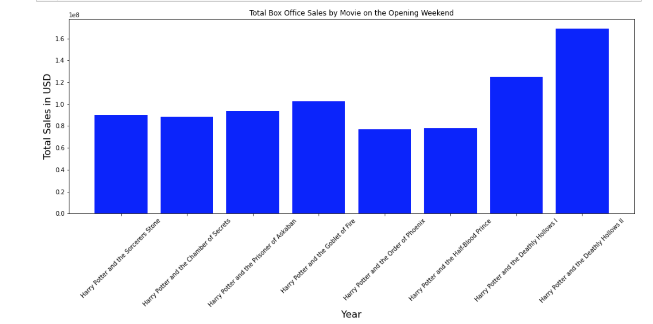
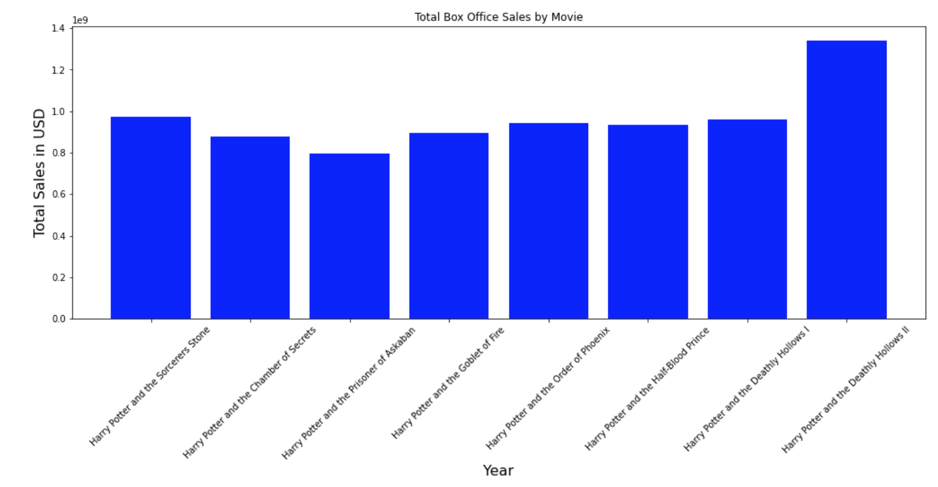
Analysis 1
1
2
3
4
5
6
7
7
1
2
3
4
5
6
7
7
→ Only according to the Box Office Sales numbers the most popular movies were Part 1 and the latter Part 7, while the biggest hype was created around the latter part of Part 7
→ Part 5 and 6 were released during the Financial Crisis which could explain less Sales on the opening weekend
Notes:
highlight changes

Slide 8
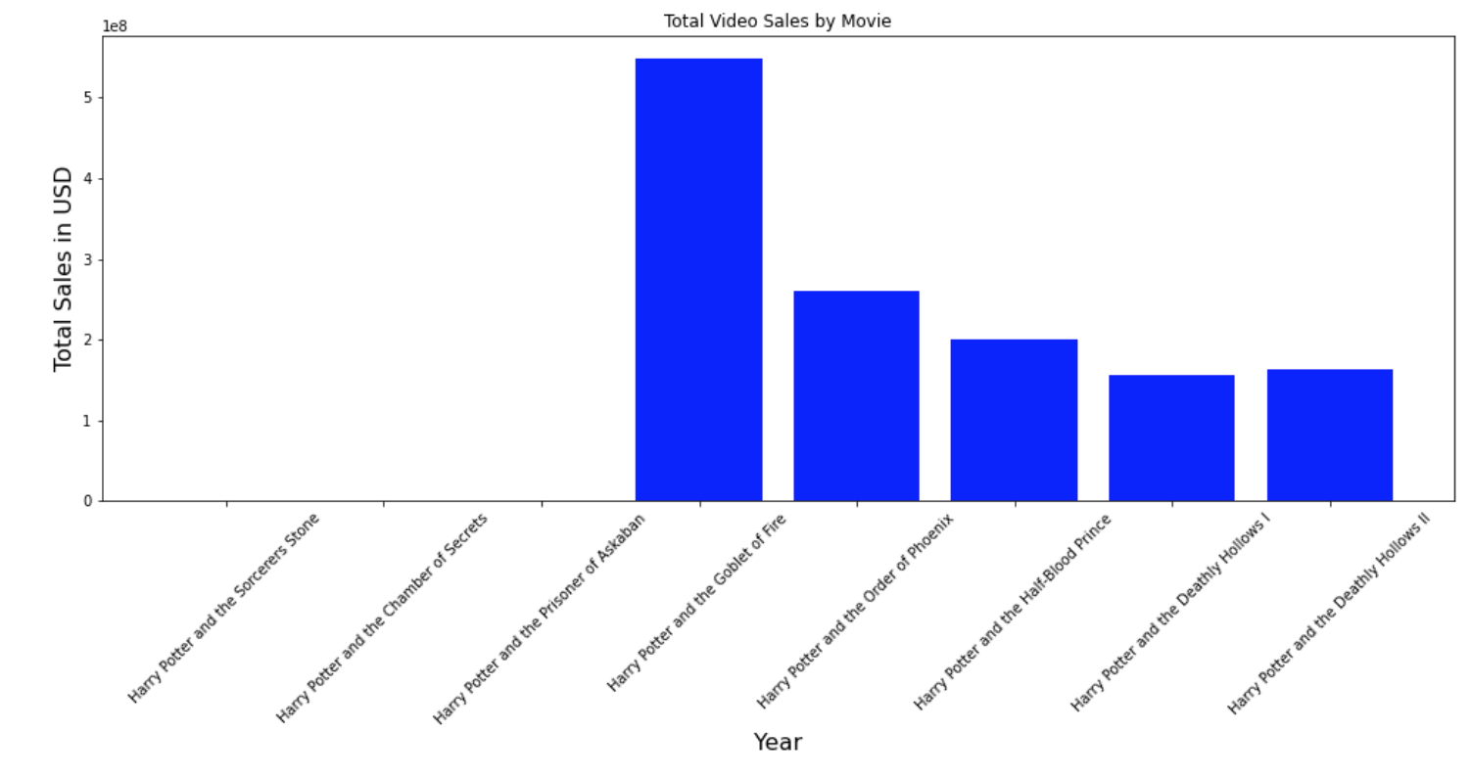
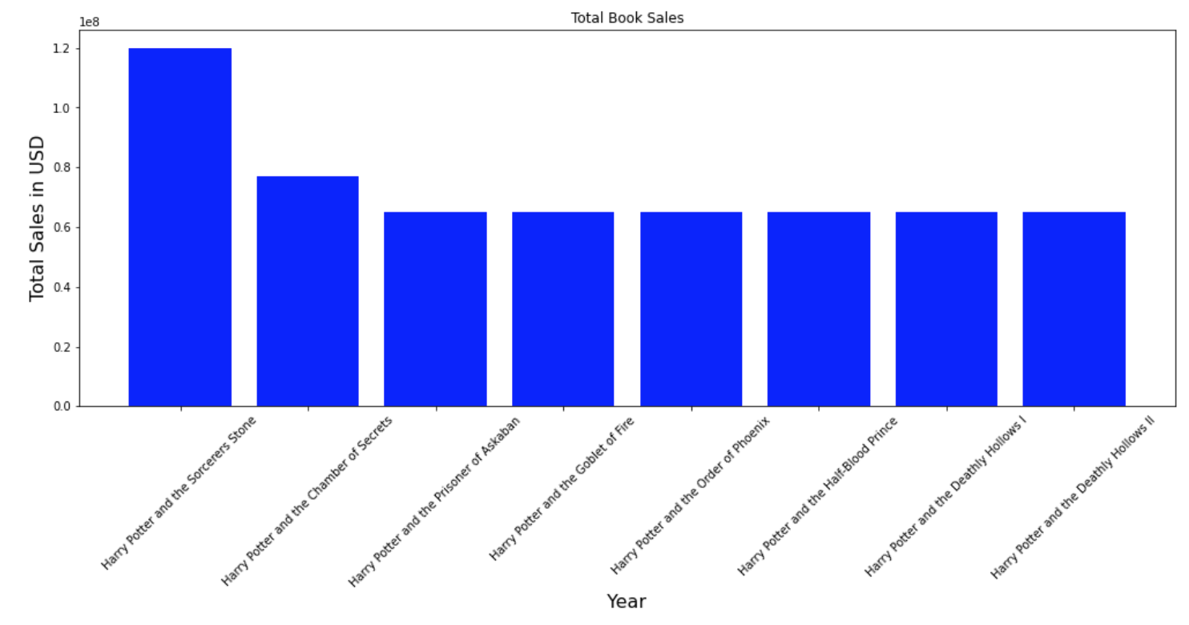
Analysis 1
4
4
1
2
3
4
5
6
7
7
4
5
6
7
7
→ The popularity of DVD’s/BlueRay Discs has dropped by 70,38 %
→ While all books are among the best selling books in History, the most copies were sold of the first part.
Notes:
highlight changes

Slide 9
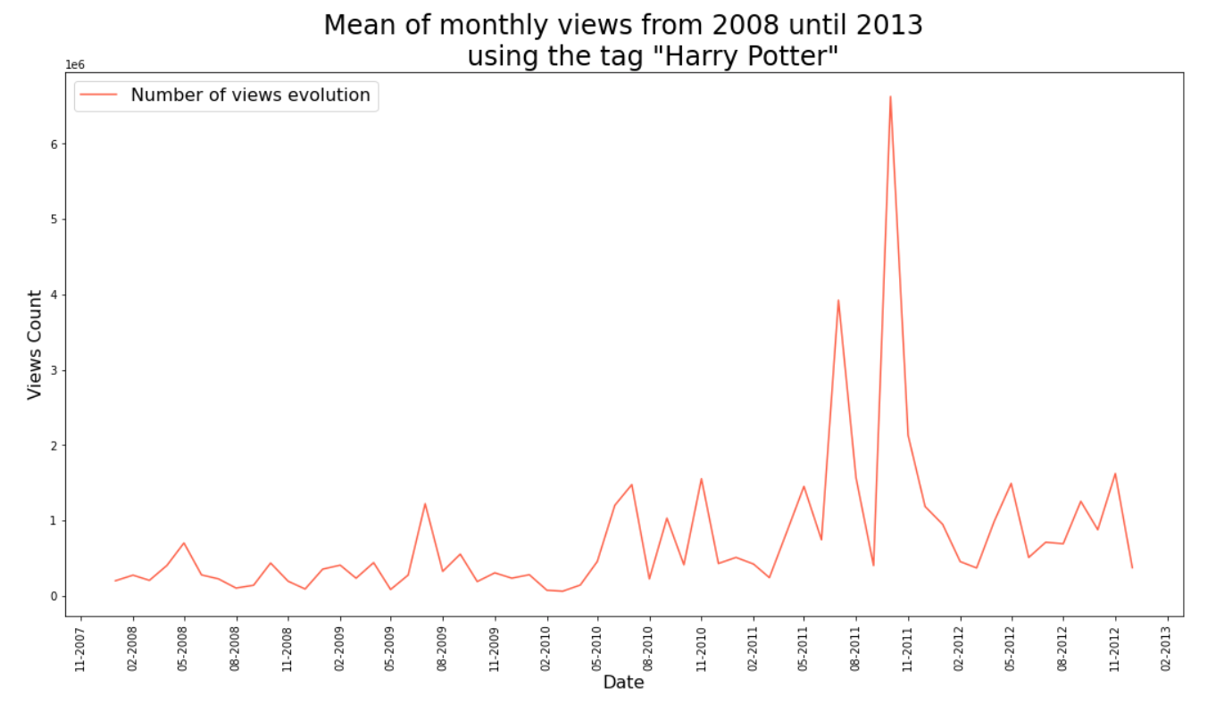
Analysis 2
How does the number of View Counts of Youtube Videos related to Harry Potter develop over time?
Notes:
as you can see, rise over time, of course keep in mind that youtube users also rose
but what happened here?

Slide 10
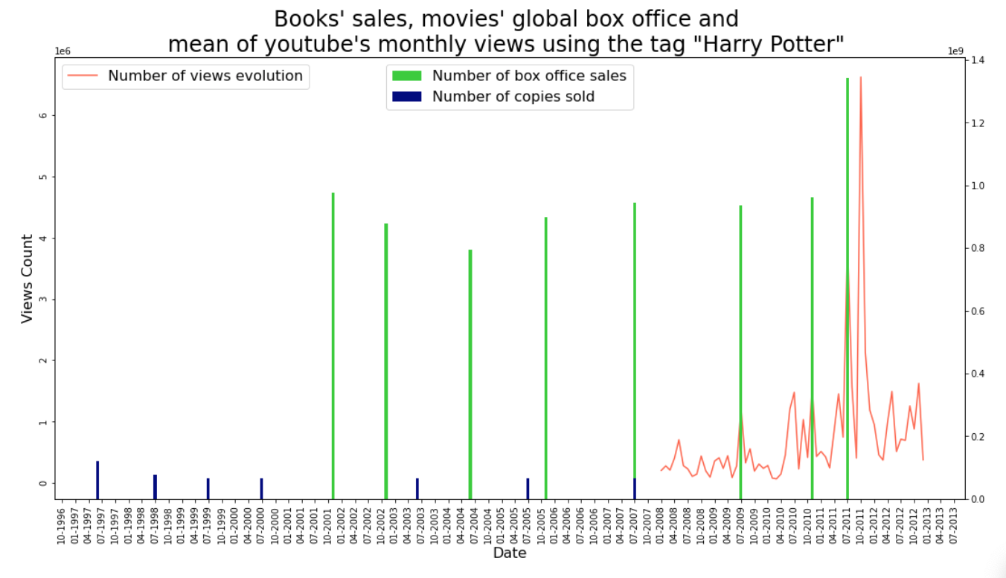
Analysis 3
How is the number of View Counts affected by movie releases?
Notes:
As we see here, the spike of the youtube views was shortly after the release of the very last movie - we believe people were trying to find out whether there would be another movie

Slide 11
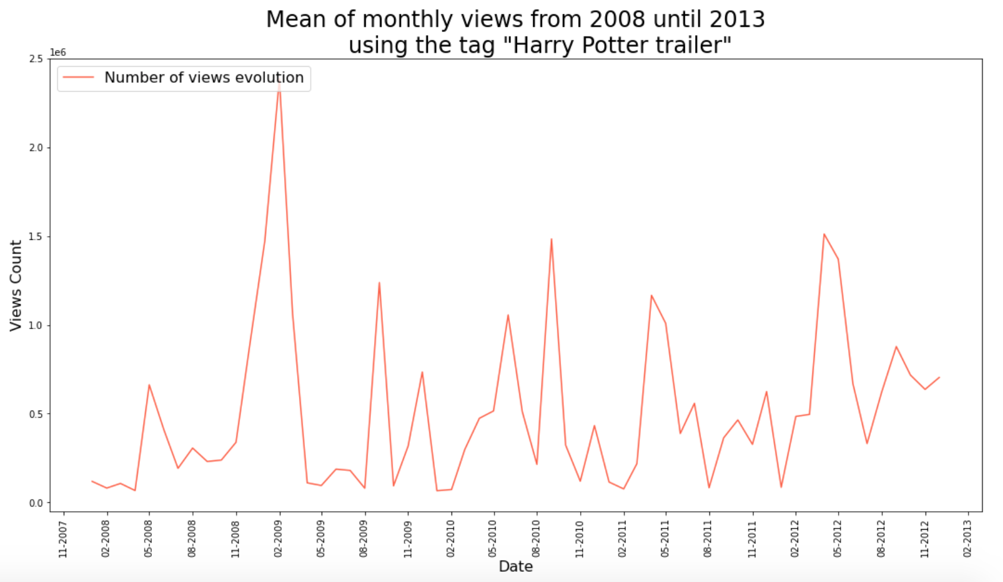
Analysis 4
How does the View Count of Official Trailers on Youtube relate to the Success of the Movie?
Notes:
align, movie dates

Slide 12
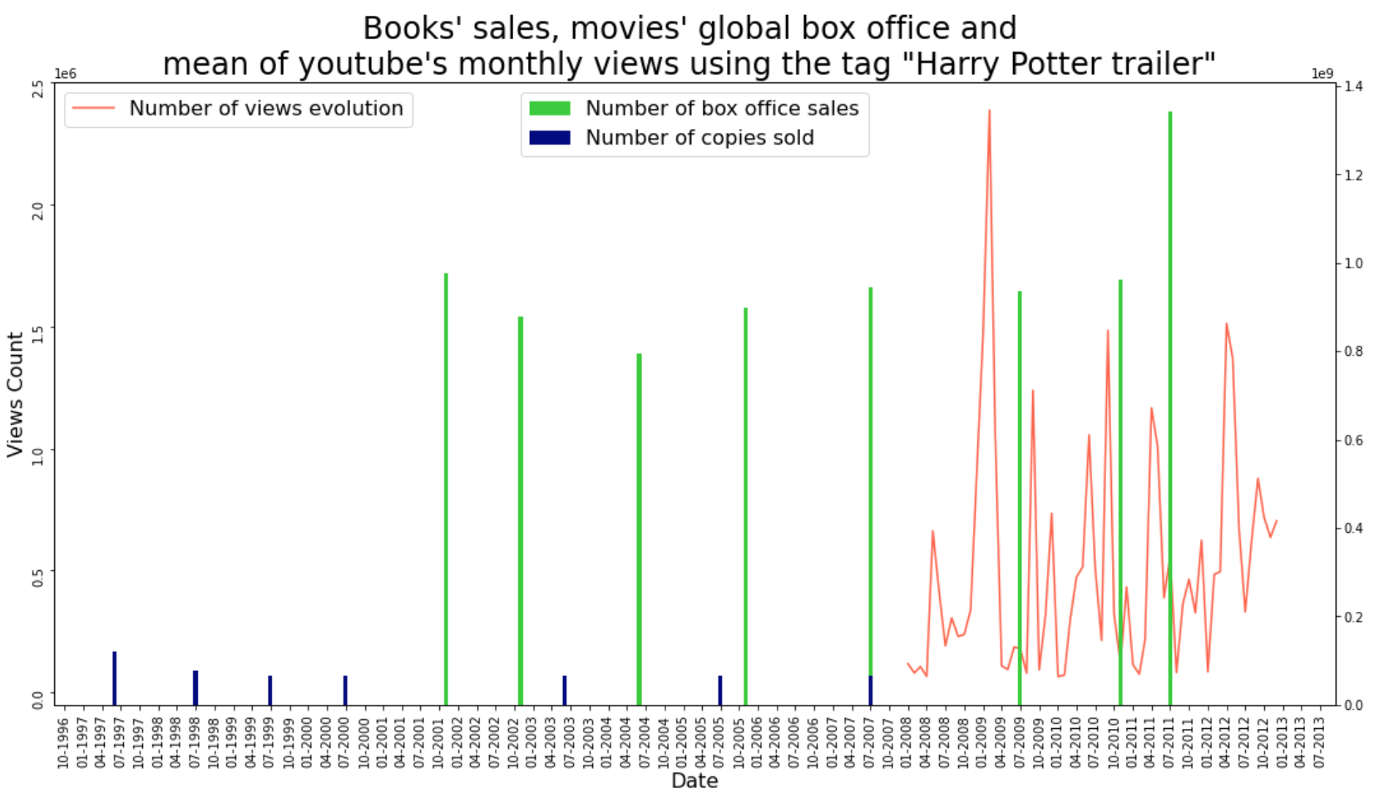
Analysis 5
Which Trailer was the most successful according to Box Office Sales?
Notes:
align

Slide 13
Summary of our Main Insights 👀
→ Only according to the Box Office Sales numbers the most popular movies were Part 1 and the latter Part 7, while the biggest hype was created around the latter part of Part 7
→ Part 5 and 6 were released during the Financial Crisis which could explain less Sales on the opening weekend
→ The popularity of DVD’s/BlueRay Discs has dropped by 70,38 %
→ While all books are among the best selling books in History, the most copies were sold of the first part.
→ Trailer 6 must have been not been very good.
→ There was a spike in Harry Potter searches after the last Movie was released - probably because people were coping with the end of an era
Notes:
sum up points

Slide 14

Code for conducting Youtube Data
DEMO TIME
Notes:
as you can see, rise over time, of course keep in mind that youtube users also rose
but what happened here?

Slide 15
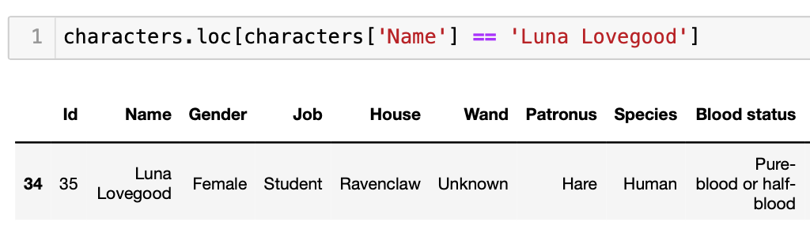
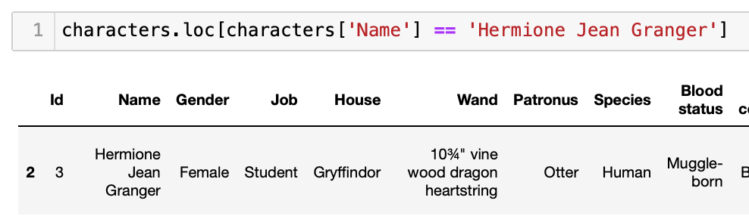
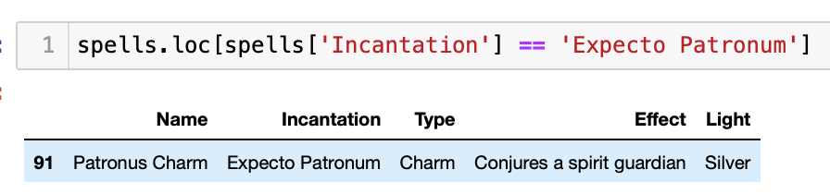
Harry Potter Quiz 💭
Which House was Luna Lovegood in ?
What is Hermione Granger’s wand made of?
What snake fangs are in the Widley Potion?
Which color is the light when the famous spell “Expecto Patronum” casted?

Slide 16
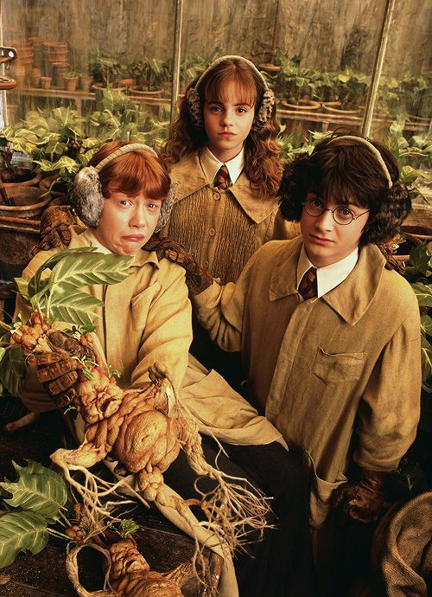
Workflow & Organisation 😎
Regular Meetings
Trello Board
Data Exploration and Flexibility

Slide 17
Learnings and Challenges 📚
Challenges:
Finding a concrete Topic & Project Objection
Understanding the expectations
Time Management
Learnings:
A lot.
What kind of information there is
How to retrieve, structure and analyse data
How to deal with imperfect data sets

Slide 18
Thank you!!
Q&A

Slide 19
Sources
Youtube Data API
Numbers.com
Wikipedia
Kaggle

